Slide 1


Parent Presentation
September 2024
Notes:
1
Make sure you have a pen and paper at the ready!

Slide 2
Phonics at Branton
We use the Read Write Inc (RWI) Scheme as our phonics program.
This is a structured approach with writing aspects included.

Slide 3
Why synthetic phonics?
“Synthetic phonics offers the vast majority of young children the best and most direct route to becoming skilled readers and writers” Sir Jim Rose
Rose Review of Reading 2006
Synthetic phonics is the ability to convert a letter or letter group into sounds that are then blended together into a word.
Notes:
3

Slide 4
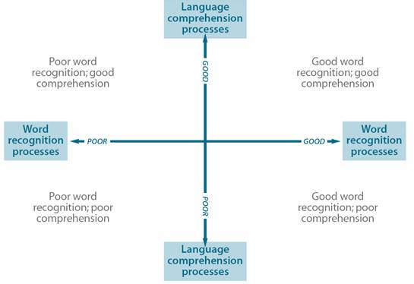
Simple view of reading
Notes:
4

Slide 5
Why Read Write Inc Phonics?
Tried and tested over many years
Systematic and structured
Early success in reading
Training and ongoing staff development
More information for parents
https://www.ruthmiskin.com/parentsandcarers/
Notes:
5

Slide 6
What is Read Write Inc Phonics?
A rapid Learn to read programme
so children can…
Read to learn for the rest of their lives
Notes:
6

Slide 7
How does it work?
Children:
Learn 44 sounds and matching letters/letter groups
Learn to blend sounds to read words
Read lots of specially written books
This is decoding.
Notes:
7

Slide 8
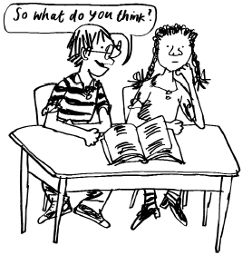
How does it work?
Children talk a lot about what they have read to show they understand.
There are questions at the back of the books to check understanding.
This is comprehension.
Notes:
8

Slide 9
Sounds
All words are made up of sounds
In the English language there are 44
sounds (phonemes)
Sound Pronunciation Guide
https://www.youtube.com/watch?v=KUbrJPAt65g
Notes:
9
Show flashcards to parents MTYT

Slide 10
Graphemes
A grapheme is a sound written down
English has more than 150 graphemes
There are more than 150 ways to represent the 44 sounds using our 26 alphabet letters.
A complex code!
Notes:
10

Slide 11
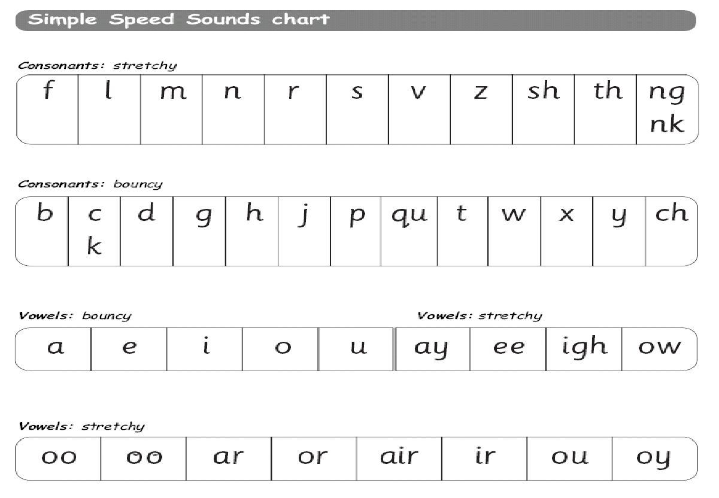
Learning the code
Children learn a simple code first
Notes:
11

Slide 12
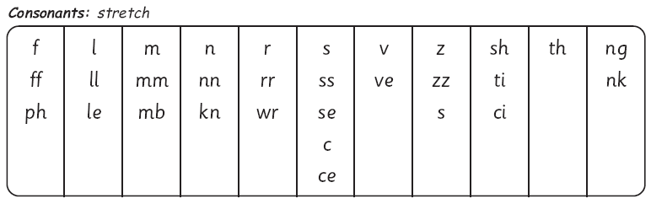
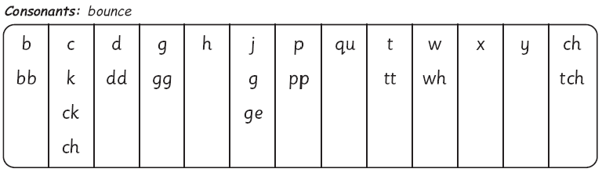
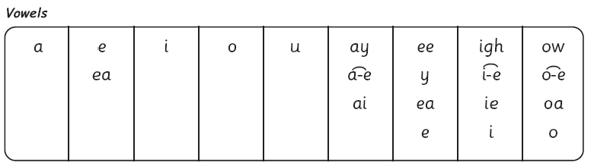
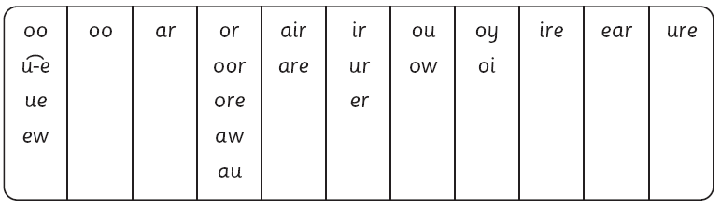
The complex English alphabetic code
Notes:
12

Slide 13
Consonants: stretchy
f | l | m | n | r | s | v | z | sh | th | ng
 |  |  |  |  |  |  |  |  |  | nk
Consonants: bouncy
b | c | d | g | h | j | p | qu | t | w | x | y | ch
 | k
Vowels: bouncy
Vowels: stretchy
a | e | i | o | u | ay | ee | igh | ow
oo | oo | ar | or | air | ir | ou | oy
Set 1 sounds
Set 2 sounds
Notes:
13

Slide 14
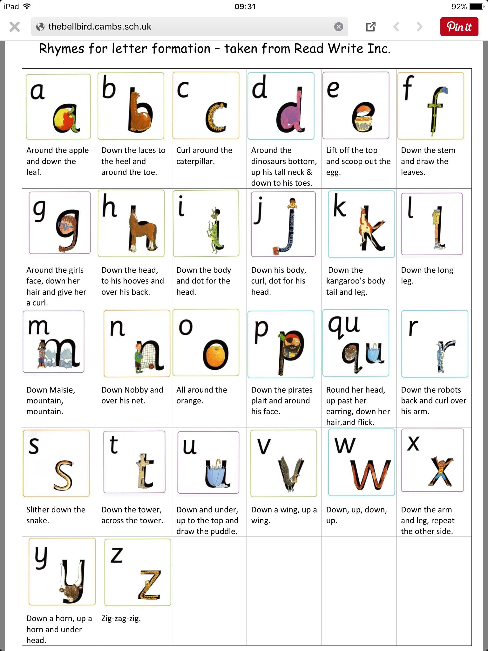

Slide 15
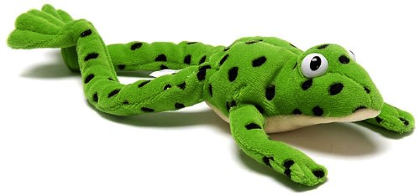
Fred...
Fred helps children learn to read
Fred can only talk in sounds...
(Fred can only say c_a_t, he can’t say cat)
We call this Fred Talk
Notes:
15

Slide 16
Fred…
If children understand Fred they can blend orally.
Blending is needed for reading.
Notes:
Copyright Ruth Miskin Literacy
16
Use My Turn Your Turn with the parents to have a go at some Fred Talk – you Fred Talk a CVC word d_o_g, they Fred Talk it back & ask them to tell you what word Fred is trying to say.

Slide 17
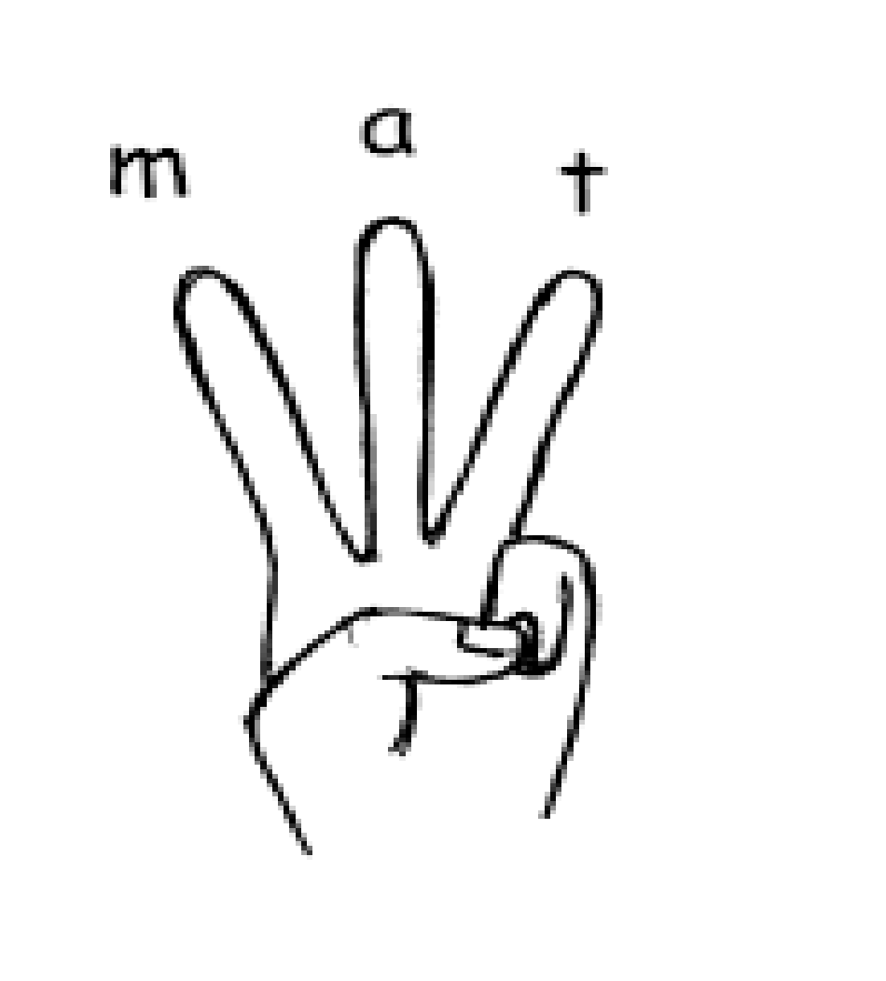
Fred...
Fred helps children learn to spell as well!
Children convert words into sounds.
They press the sounds they hear on to their fingers...
We call this Fred Fingers.
Notes:
Use My Turn Your Turn with the parents – say “show me three fingers – the word is dog.”
17

Slide 18
Green words
Green words are words we can Fred talk. (Phonetically decodable)
These are words we can segment and blend.
For example – play and coin.

Slide 19
Red Words
These were called tricky words.
Red words are words we can Fred talk.
For example ‘I’, ‘the’ and ‘said’.
You can’t Fred a red!

Slide 20
Terminology
MTYT – my turn your turn.
Turn to your partner – talk to their partner.
Fred talk – using the Fred the frog to sound out and segment the letters in the word.

Slide 21

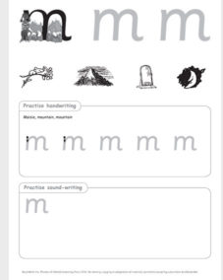



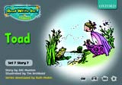
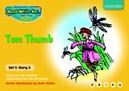
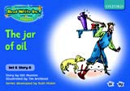

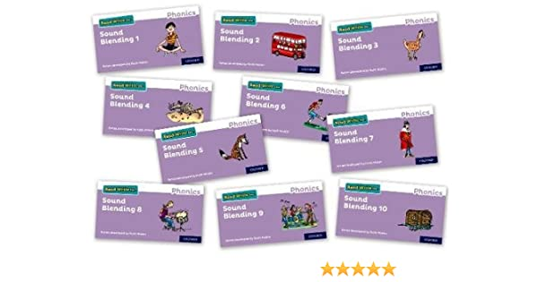
RWI Resources

Slide 22
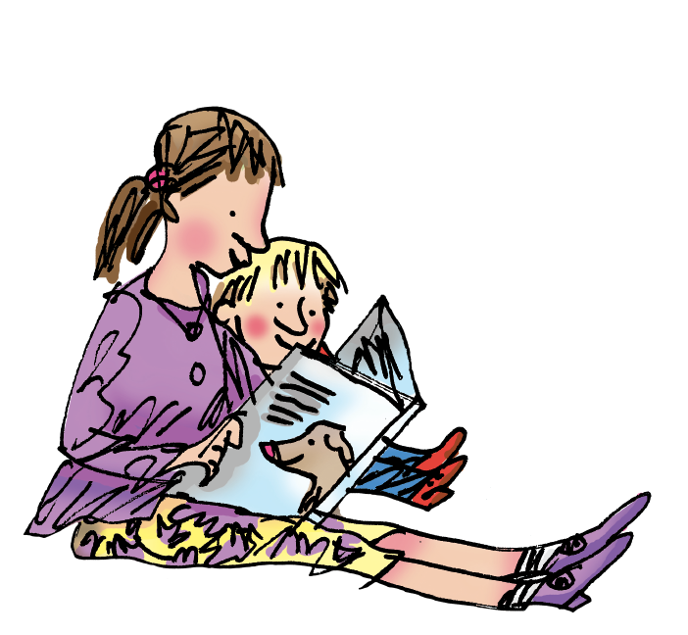
How to help your child at home…

Slide 23
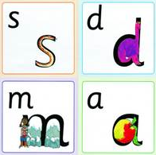
You can practice pronouncing sounds.
Remember no ‘fuh’ and ‘luh’!
Notes:
23

Slide 24
Reading books home
Books are sent home to be shared with your child.

Slide 25
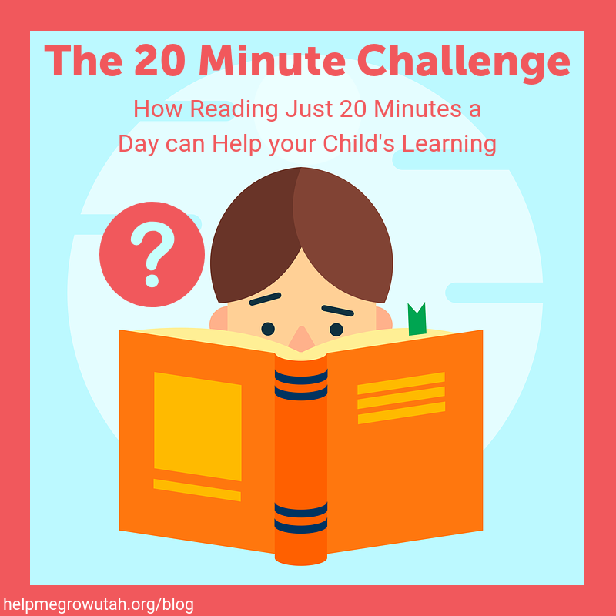
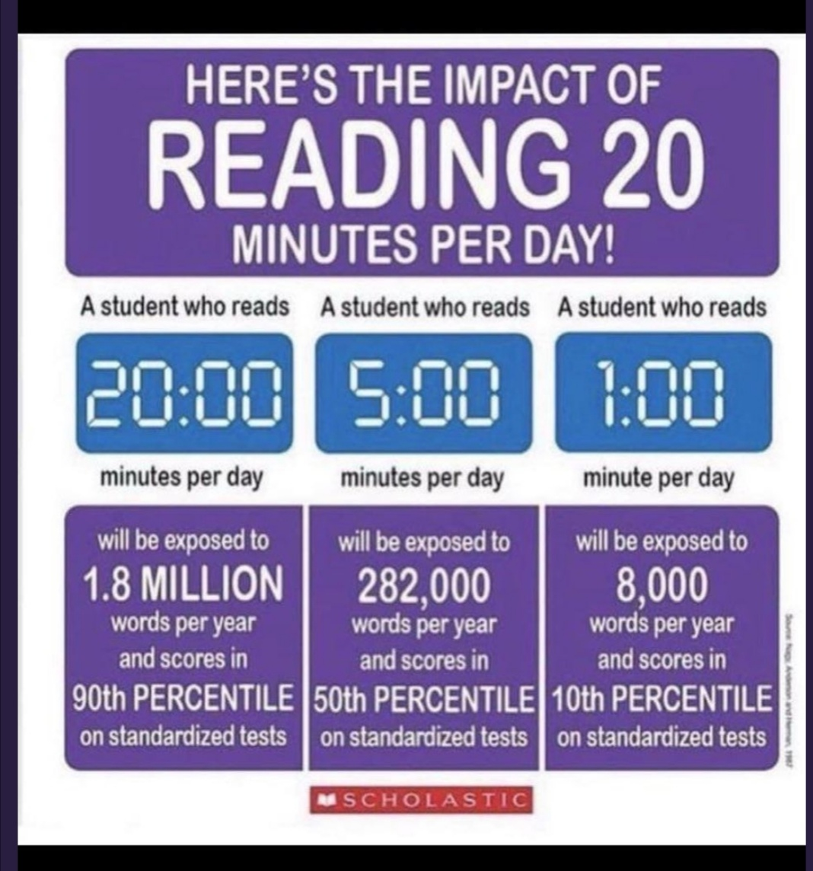
Reading with your child at home.

Slide 26
And...
By reading to your child lots of lovely stories and asking lots of questions!
Use these prompts to help you:
What is that character thinking?
What is happening?
What do you think
happens next?
What is the character saying?
What do you
think that character is
feeling now?
Notes:
26

Slide 27

Any questions?

Slide 28

Thank you...
Happy reading!

