Slide 1
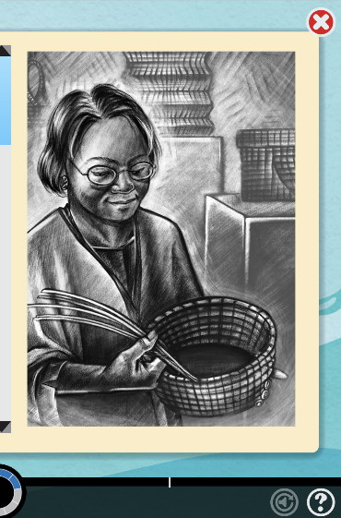
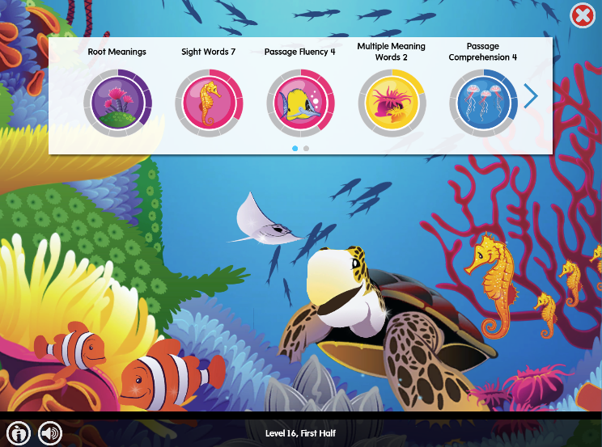
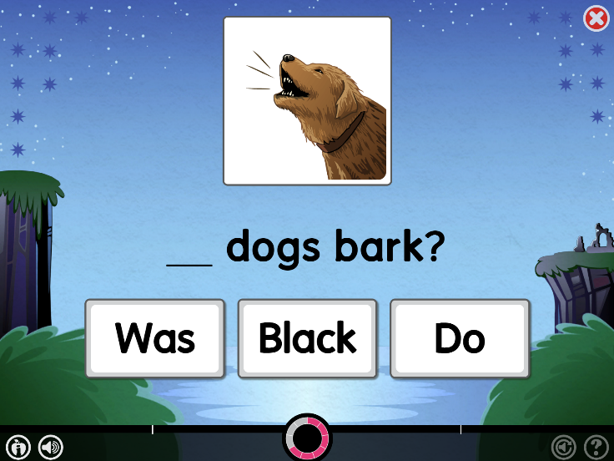
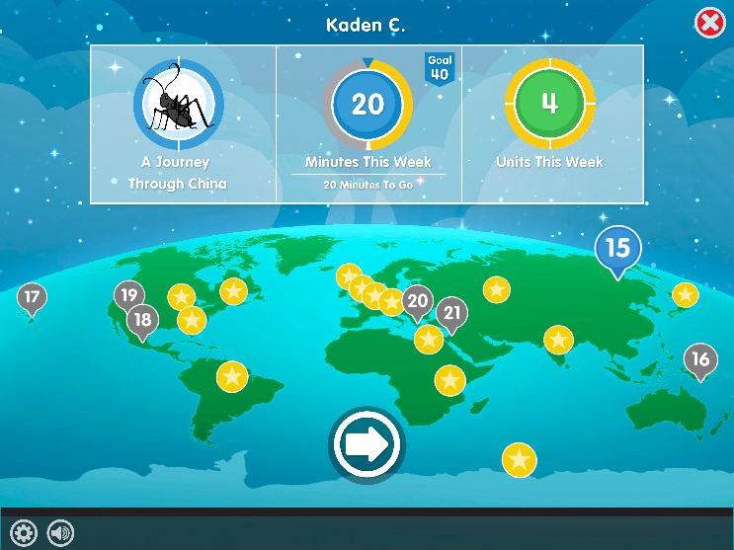
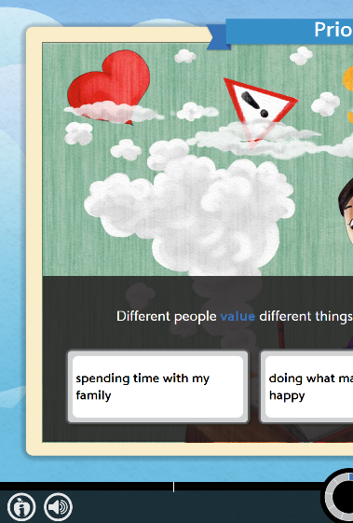
Lexia Core5 Reading
Information for Parents

Slide 2

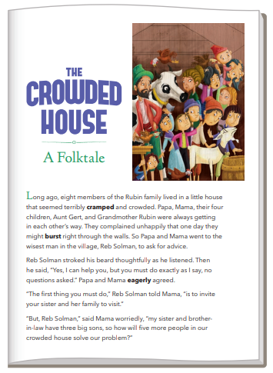
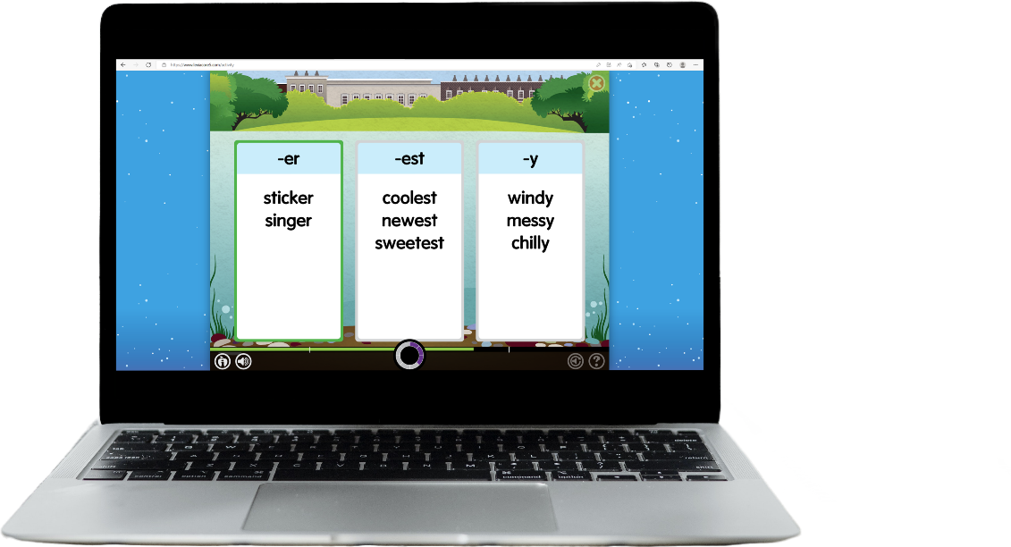
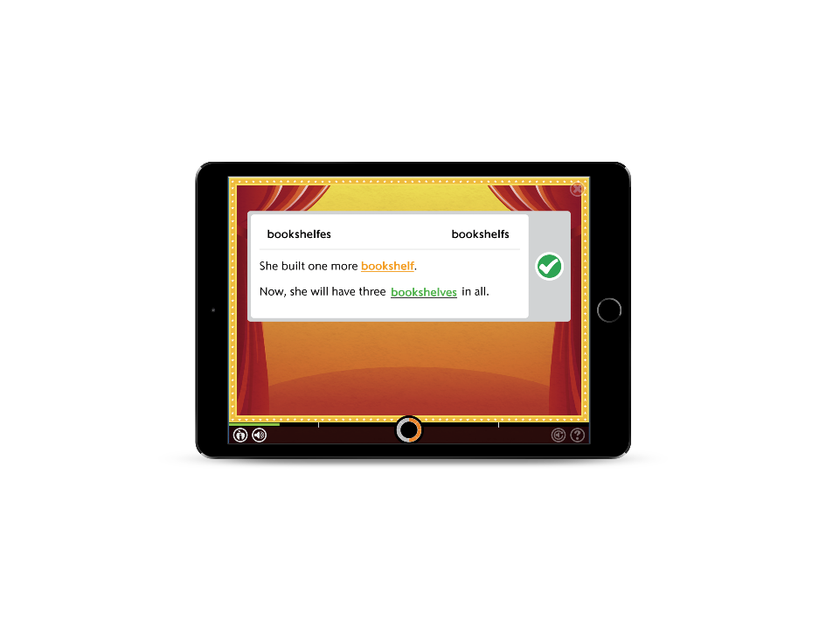
Presentation Aim
Software Overview
Integrated system
Benefits for learners
Learner experience
Home Use Best Practice
Questions and Demonstration

Slide 3
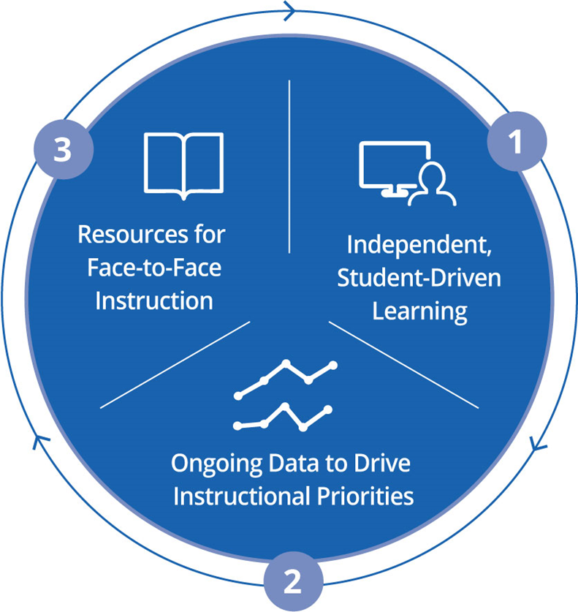
What is Lexia?
Integrated System
Personalised, independent practise and instruction
Accurately monitors progress
Drives instructional decisions
Builds literacy skills from Reception – Year 6.

Slide 4

Built on the Science of Reading
Scarborough’s Reading Rope (2001)
Notes:
Click image to

Slide 5






What makes a successful reader?
Lexia Core5® Reading covers the six areas of reading instruction, including activities focused on academic vocabulary and structural analysis. This begins with oral
language and listening comprehension, building to reading comprehension.
Area of Reading Instruction and Skills
Phonological
Awareness
Phonics
Structural Analysis
Automaticity/ Fluency
Vocabulary
Comprehension

Slide 6
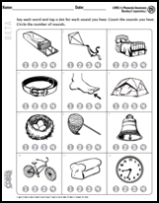
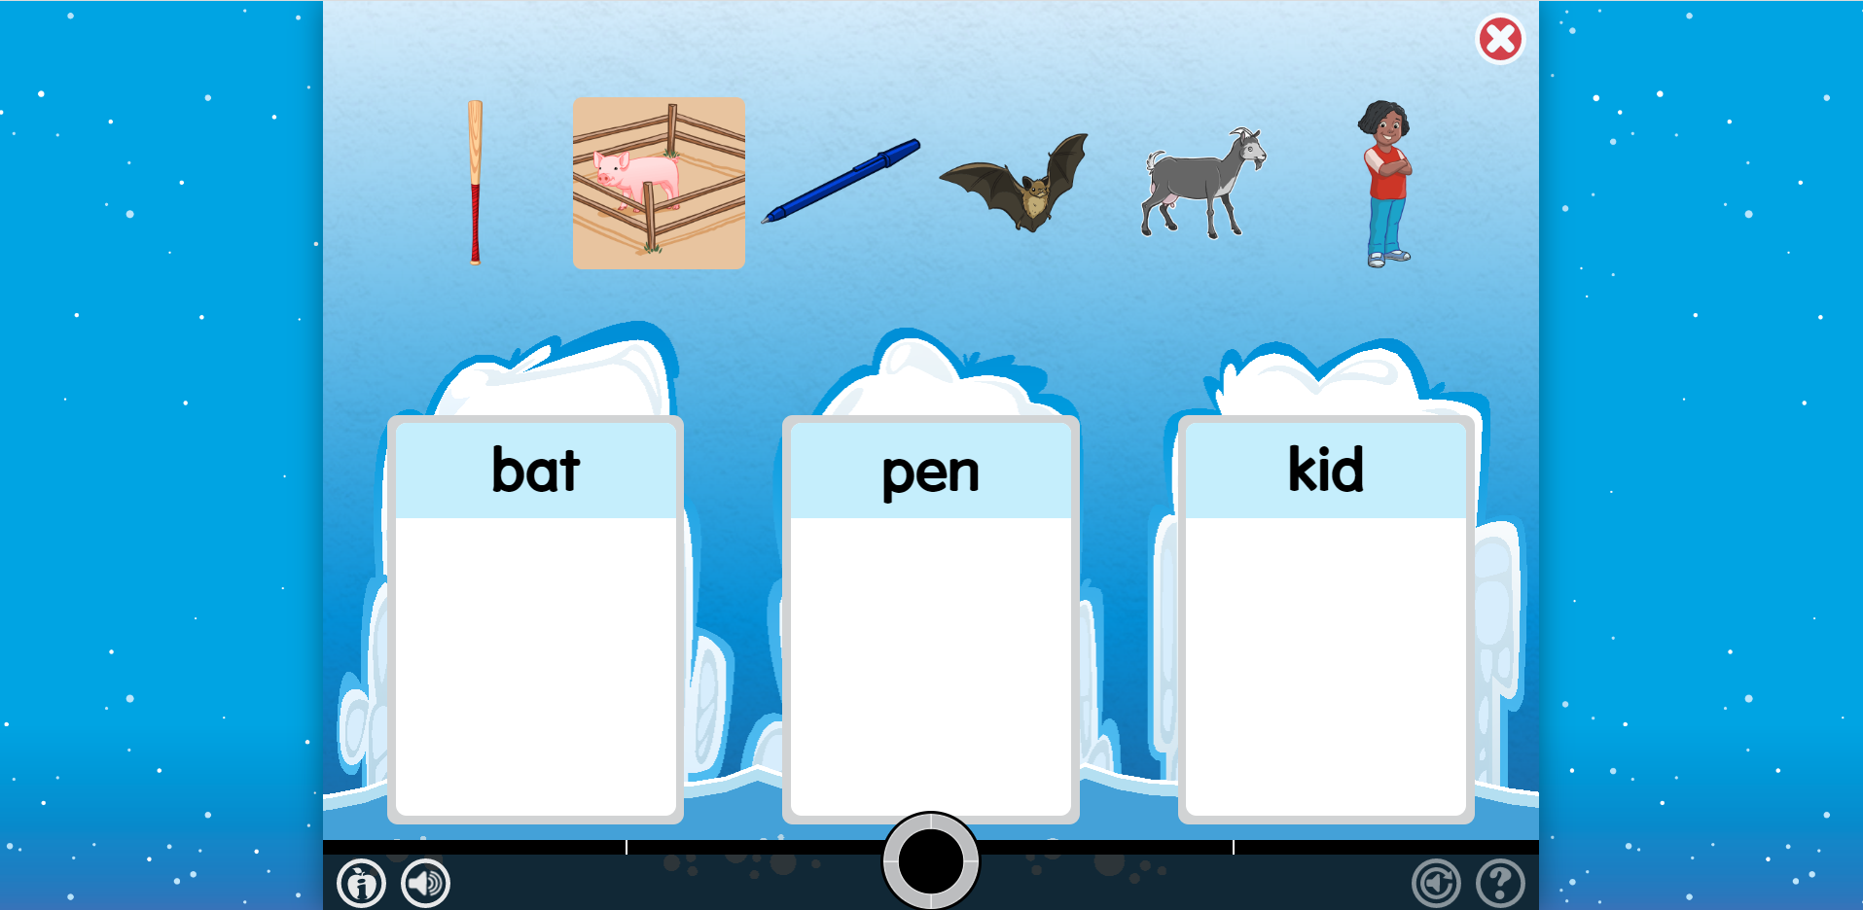
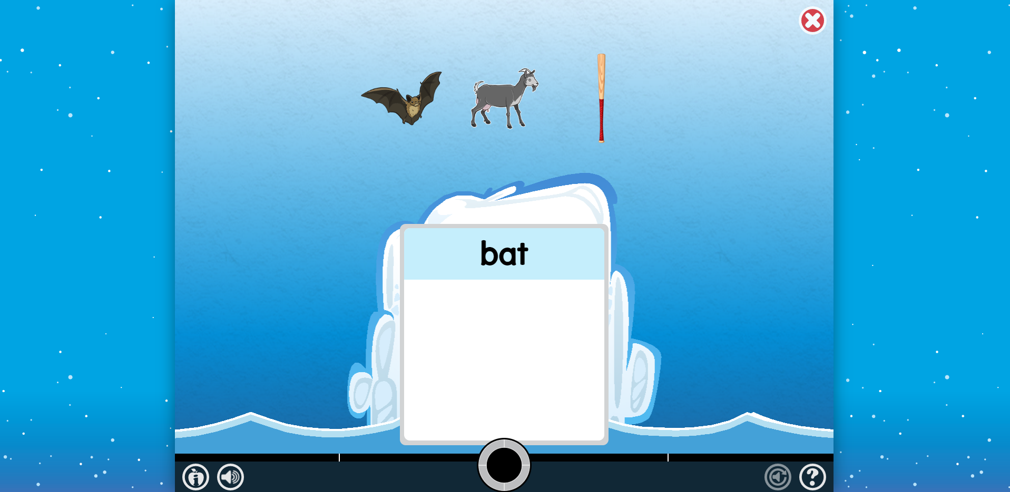
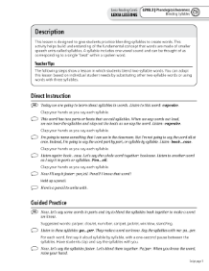
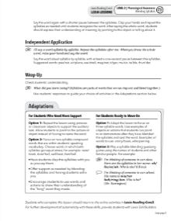
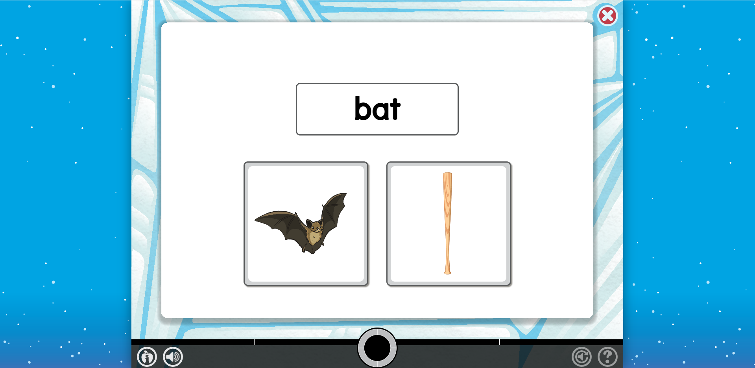
Lexia Core5 Reading Instructional Model
Standard Mode
Independent application
Demonstrate Mastery
Skill Builders®
Paper and pencil:
Develop automaticity
& expressive skills
Guided Practice
Scaffolded support
Direct Instruction
Explicit teaching
Struggle repeatedly
Lexia Lessons®
Teacher-led instruction

Slide 7

Proven Results
Lexia improves reading scores
Those with greatest needs benefit the most
Closes the Reading Gap
Supports pupils with SEN and English Language Learners
Benefits of Lexia are tied to strong usage and fidelity of implementation

Slide 8
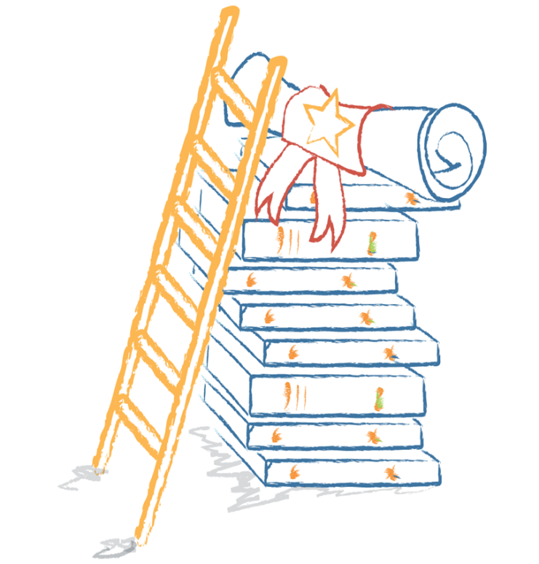
Benefits for Pupils
Regular independent practise (home & school)
Truly personalised
Engaging
Motivating elements (extrinsic & intrinsic)
Instant feedback
Improved curriculum access

Slide 9
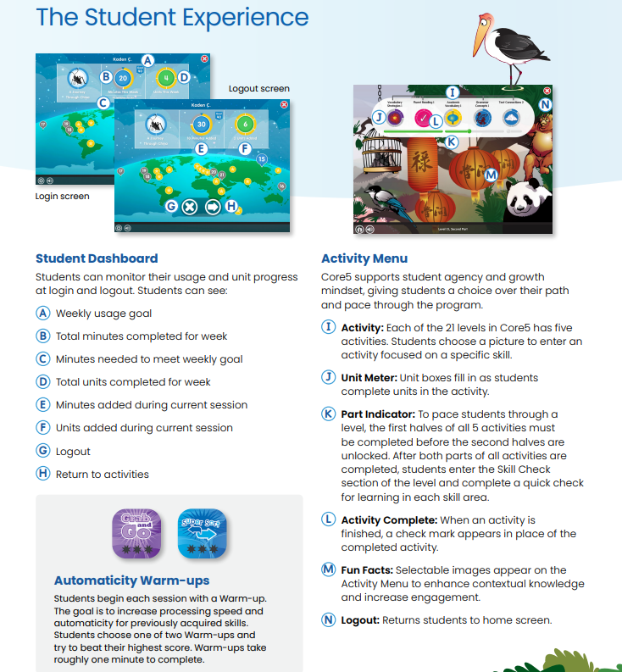
The Student Experience

Slide 10
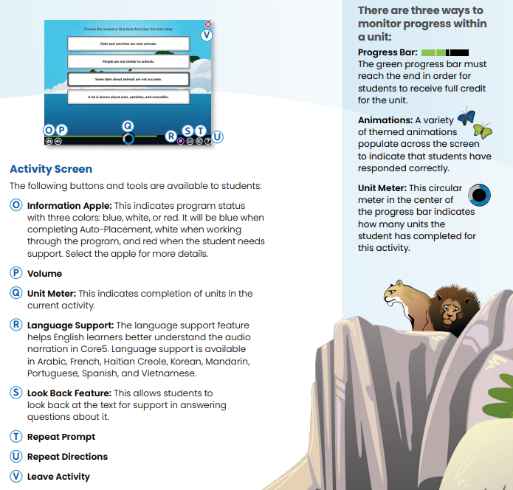
The Student Experience

Slide 11
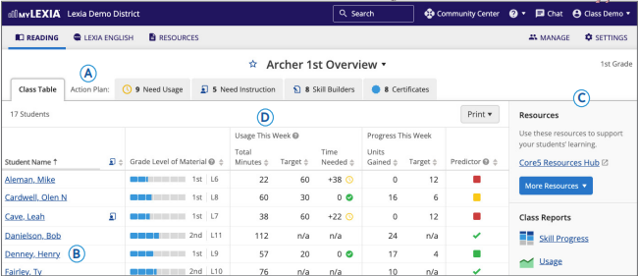
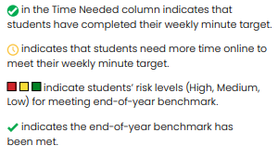
The Teacher Experience

Slide 12
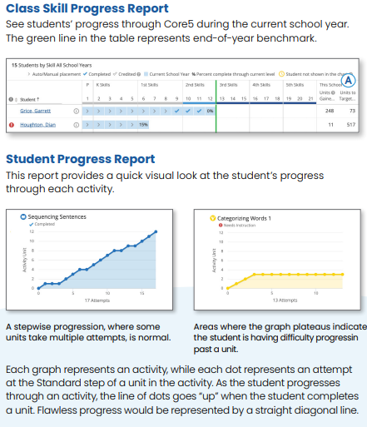
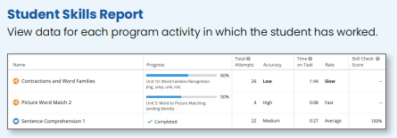
The Teacher Experience

Slide 13



Best Practice At Home
Tips to get the most out of Lexia:
Ensure timetabled Lexia time is built into your day.
(typically, 3-4 x 30-minute sessions / week)
Ensure your learners are working as independently as possible.
Use the Student Dashboard data to set targets and celebrate success!

Slide 14


Thank you!

